Slide 1

MANAGEMENT OF NATURAL RESOURCES
Bishnoi Community and
Chipko Andolan

Slide 2
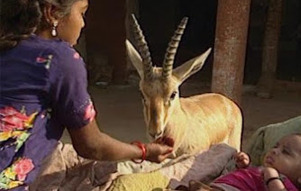
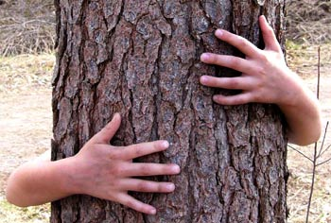
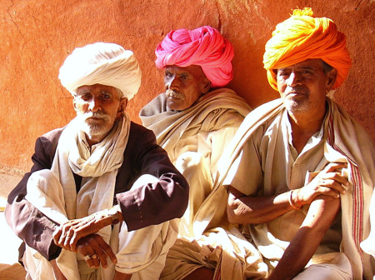
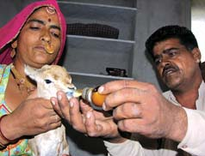
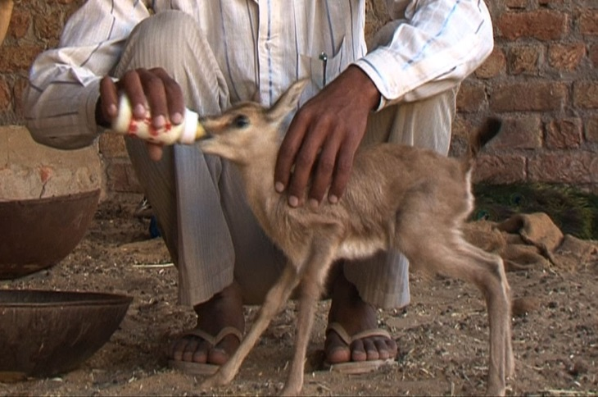
For example, the case of the Bishnoi community in Rajasthan, for whom conservation of forest and wildlife has been a religious tenet.
Bishnoi community

Slide 3
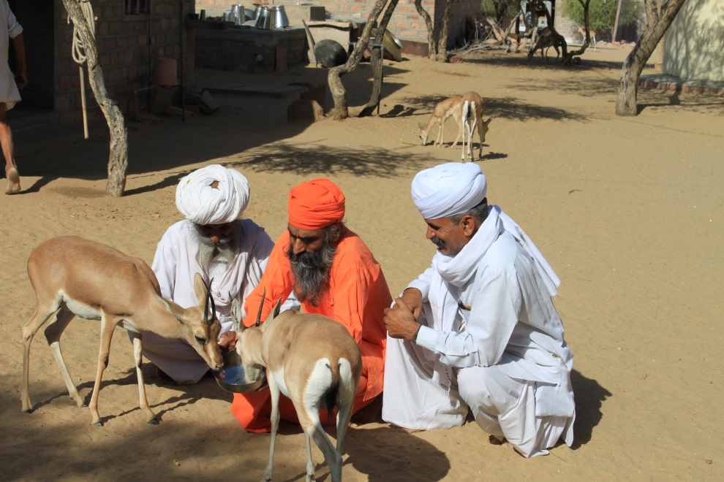
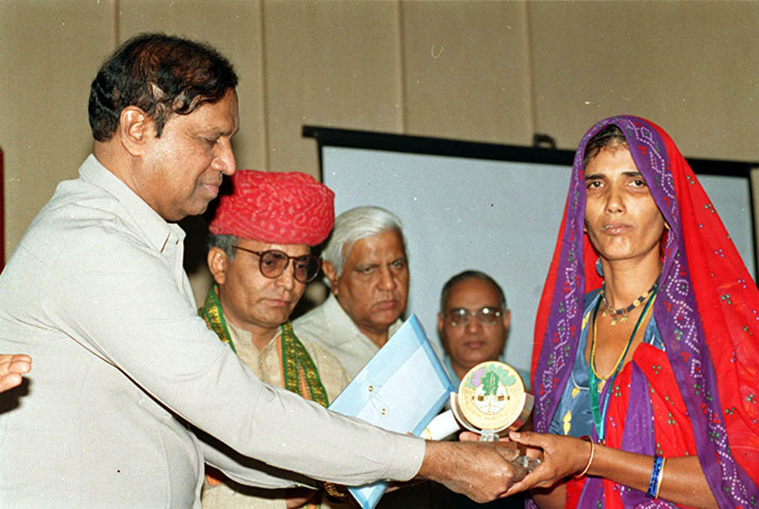
The Government of India has recently instituted an ‘Amrita Devi Bishnoi National Award for Wildlife Conservation’ in the memory of Amrita Devi Bishnoi.
Amrita Devi Bishnoi

Slide 4
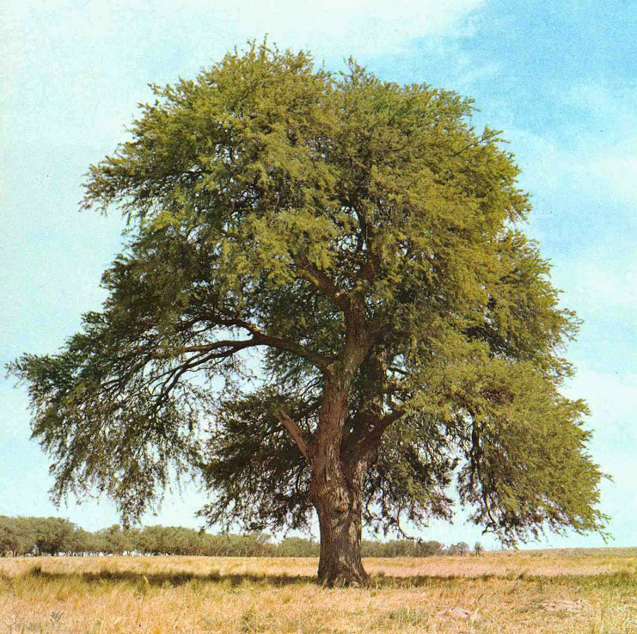
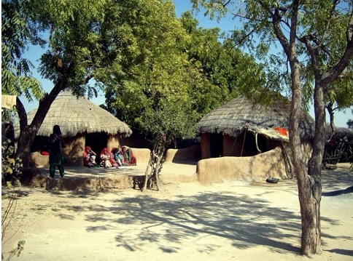
Amrita Devi Bishnoi in 1931 sacrificed her life along with 363 others for the protection of ‘khejri’ trees in Khejrali village near Jodhpur in Rajasthan.

Slide 5
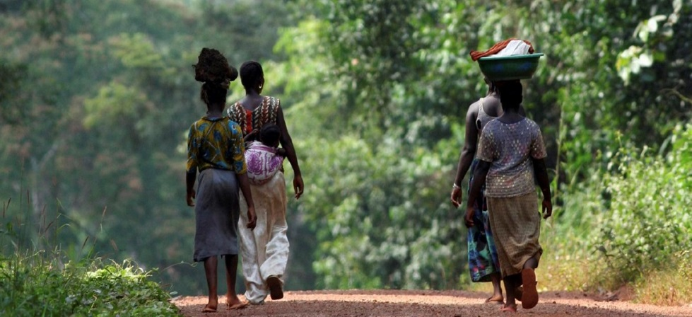


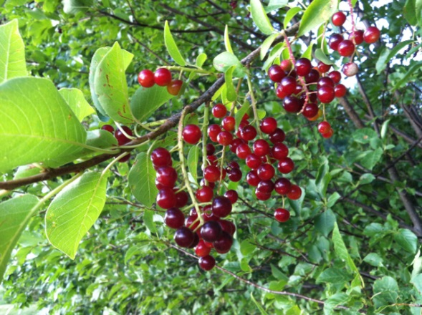
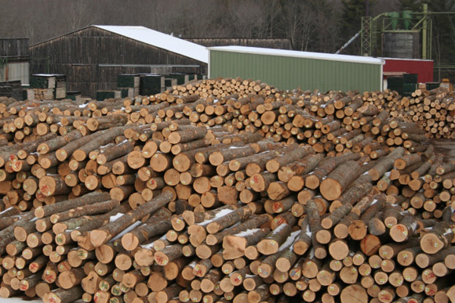
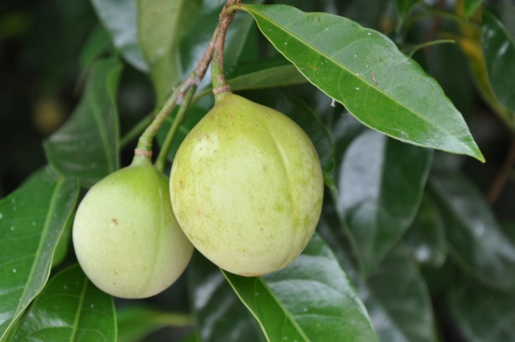
Sustainable Management
Forest resources are often made available for industrial use at rates far below the market value while these are denied to the local people.

Slide 6
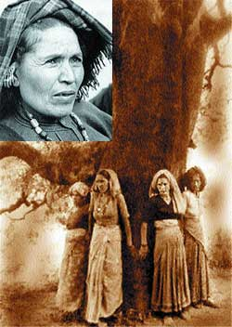
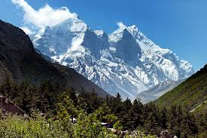
Sustainable Management
The Chipko Andolan was the result of a grassroot level effort to end the alienation of people from their forests.
Hug the Trees Movement
The movement originated from an incident in a remote village called Reni in Garhwal, high-up in the Himalayas during the early 1970s.

Slide 7
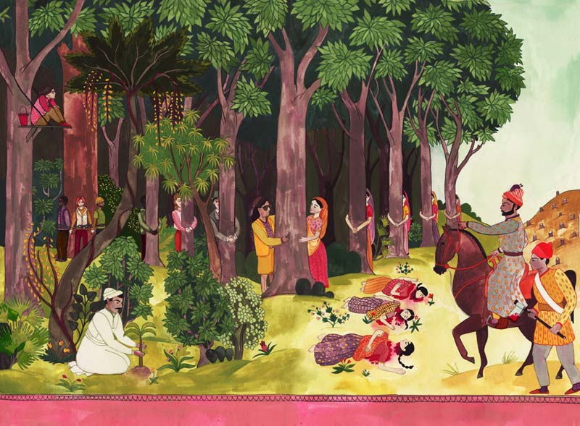
On a particular day, the contractor’s workers appeared in the forest to cut the trees while the men folk were absent.
Undeterred, the women of the village reached the forest quickly and clasped the tree trunks thus preventing the workers from felling the trees.
There was a dispute between the local villagers and a logging contractor who had been allowed to fell trees in a forest close to the village.

Slide 8
Thank You

